Slide 1


ALTSCHOOL OF Cybersecurity (BARAKA 2025)
MONTH 2 – WEEK 2

Slide 2
Refresher- Last week
Risk Management
  Overview of Identifying Risk and Type of Risk
  Risk Identification Techniques
  Accessing Risk and Prioritizing Risk
  Mitigating Risk Monitoring and Communicating in Risk Management
  Risk Management Frameworks – Overview
  Importance of Risk Management Frameworks and Primary Components of RMFs
  Top Risk Management Frameworks Today.
  Benefits of Risk Management Frameworks and Framing your Risks
Introducing Key Legislations and Regulations, Compliance Requirements and Standards
  Introduction to Key legislations and Regulations (GDPR, HIPAA, NDPA, CCPA, etc)
  Compliance Requirements and Standards
  Examples of Cybersecurity Standards (ISO 27001, PCIDSS, NIST)

Slide 3
MONTH 2 - WEEK 2
Introduction to Networks and Network Models
  Introduction to Networks and Networking Models (OSI, TCP/IP)
  Importance and Components of Networks
  Types of Networks
  A Day in the Life –Learning Networks
  Network Models –OSI and TCP/IP
Network Topologies and Network Devices
  Network Topologies (Bus, Star, Ring, Mesh, Hybrid)
  Networking Devices – Routers, Switches, Hubs

Slide 4
Introduction to Networks and Network Models
Day 1

Slide 5
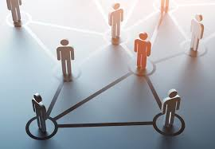
NETWORKS - INTRODUCTION
Networks are all around us. They provide us with a way to communicate and share information and resources with individuals in the same location or around the world. Networks require an extensive array of technologies and procedures that can readily adapt to varying conditions and requirements.

Slide 6
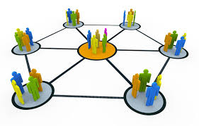
NETWORK AFFECTS OUR LIVES
Among all of the essentials for human existence, the need to interact with others ranks just below our need to sustain life. Communication is almost as important to us as our reliance on air, water, food, and shelter.
In today’s world, through the use of networks, we are connected as never before. People with ideas can communicate instantly with others to make those ideas reality. News events and discoveries are known worldwide in seconds. Individuals can even connect and play games with friends physically separated by oceans and continents.

Slide 7
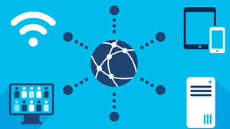
NETWORK - DEFINITION
A network is a collection of interconnected devices (such as computers, servers, switches, routers, and other hardware) that communicate with each other to share resources, exchange data, and enable digital communication using standardized protocols over wired or wireless connections.

Slide 8
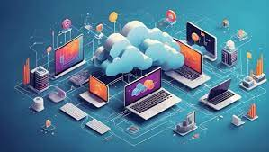
NETWORK COMPONENTS
Many different components are required to enable a network to provide services and resources. These various components work together to ensure that resources are delivered in an efficient manner to those requiring the services.

Slide 9
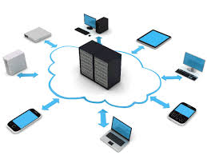
NETWORK COMPONENTS
Host Roles
  If you want to be part of a global online community, your computer, tablet, or smartphone must first be connected to a network. That network must be connected to the internet.
  Any computer that is connected to a network and that participates directly in network communication is classified as a host. Hosts can be called end devices. Some hosts are also called clients. However, the term host specifically refers to a device on a network that is assigned a number for communication purposes. This number, which identifies the host within the particular network, is called the Internet Protocol (IP) address.
  An IP address identifies the host and the network to which the host is attached.

Slide 10
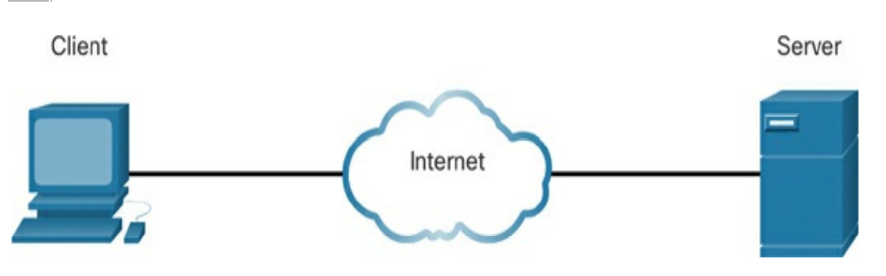
NETWORK COMPONENTS
Host
  If you want to be part of a global online community, your computer, tablet, or smartphone must first be connected to a network. That network must be connected to the internet.
  Any computer that is connected to a network and that participates directly in network communication is classified as a host. Hosts can be called end devices. Some hosts are also called clients. However, the term host specifically refers to a device on a network that is assigned a number for communication purposes. This number, which identifies the host within the particular network, is called the Internet Protocol (IP) address.
  An IP address identifies the host and the network to which the host is attached.

Slide 11
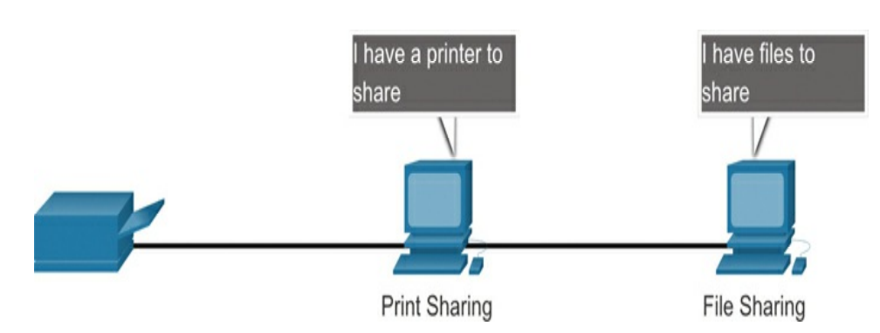
NETWORK COMPONENTS
Peer-to-Peer
  Client and server software usually run on separate computers, but it is also possible for one computer to be used for both roles at the same time. In small businesses and homes, many computers function as both servers and clients on the network. This type of network, called a peer-to-peer network.

Slide 12
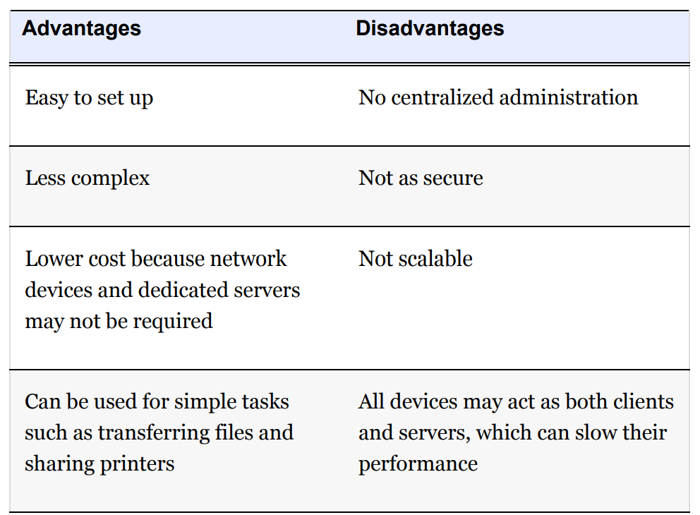
NETWORK COMPONENTS
Peer-to-Peer

Slide 13
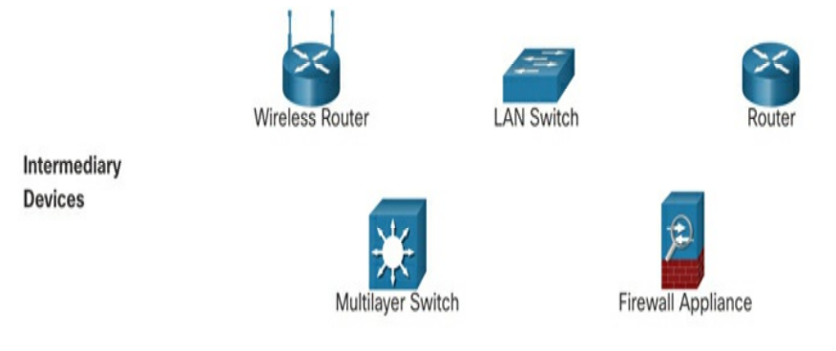
NETWORK COMPONENTS
Intermediary Devices
  Intermediary devices connect individual end devices to a network. They can connect multiple individual networks to form an internetwork. These intermediary devices provide connectivity and ensure that data flows across the network.

Slide 14
NETWORK COMPONENTS
End Devices
  The network devices that people are most familiar with are end devices. To distinguish one end device from another, each end device on a network has an address. When an end device initiates communication, it uses the address of the destination end device to specify where to deliver the message. An end device is either the source or destination of a message transmitted over the network.

Slide 15
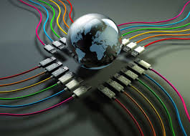
NETWORK COMPONENTS
Network Media
  Communication transmits across a network on media. The media provide the channel over which a message travels from source to destination. Modern networks primarily use three types of media to interconnect devices:
    Metal wires within cables: Data is encoded into electrical impulses.
    Glass or plastic fibers within cables (fiber-optic cable): Data is encoded into pulses of light.
    Wireless transmission: Data is encoded via modulation of specific frequencies of electromagnetic waves.

Slide 16
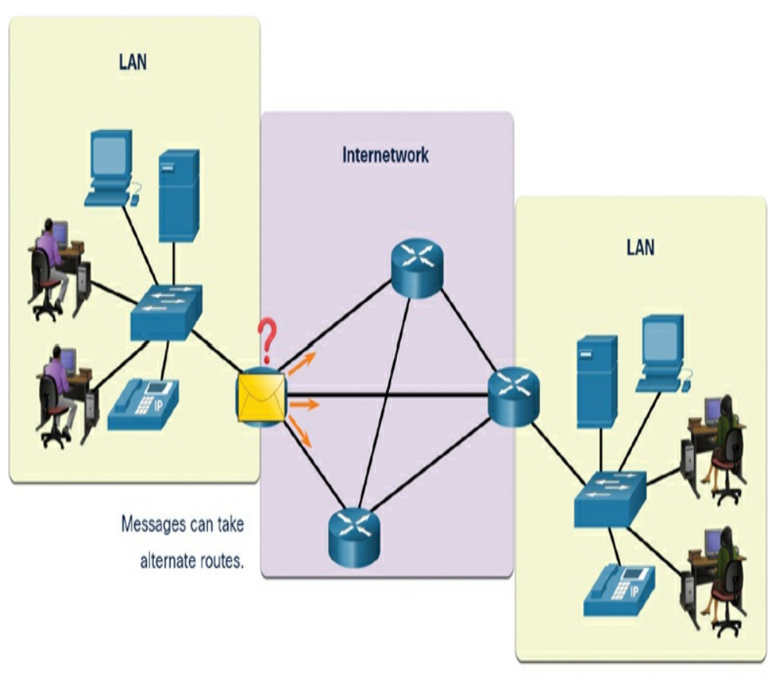
NETWORK DATA EXCHANGE BETWEEN END DEVICES

Slide 17
Network components
Day 1

Slide 18
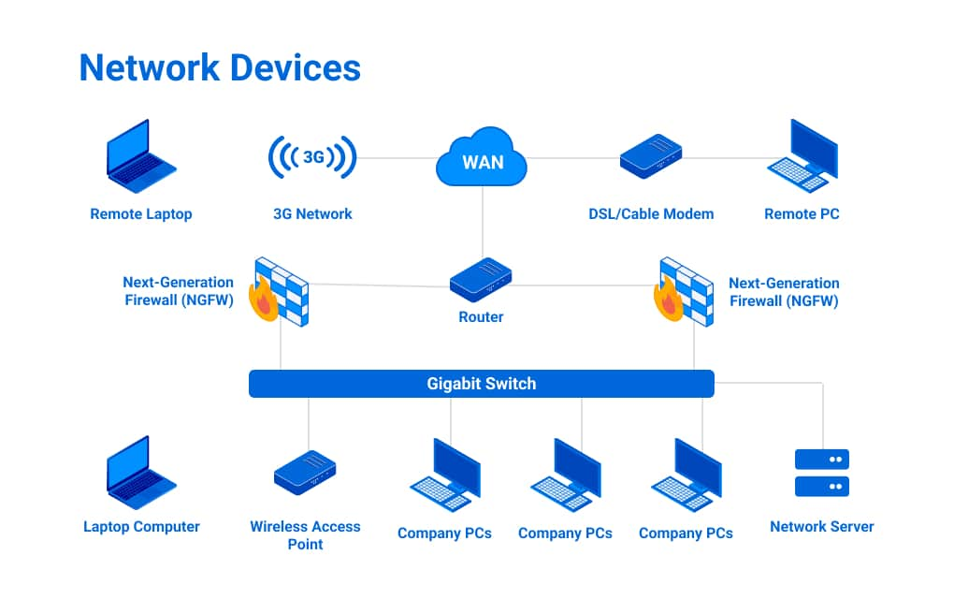
NETWORK components
A computer network is made up of several components, including hardware like network interface cards (NICs), routers, switches, and modems, as well as software like operating systems and network protocols.
A network component refers to a device, software, or hardware unit that plays a specific role in network communication

Slide 19
NETWORK components
Network devices are critical for establishing and managing networks. The purpose of a computer network is to share resources like files, printers, and internet connections among an organization’s users and devices. They ensure data is accurately routed and secured, supporting network services and applications’ effective and reliable operation.
Without network devices, your IT infrastructure would lack the ability to manage data traffic, leading to inefficiencies, data loss, and security vulnerabilities. Network devices also enable scalability for businesses, allowing networks to adapt to changing business needs, which is essential for maintaining optimal performance and protecting against cyber threats.

Slide 20
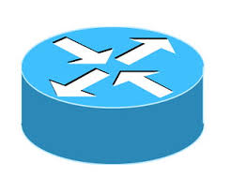
NETWORK components - Routers
Routers
  The main job of a router is to direct traffic. Routers transfer packets to their destinations by charting a path through interconnected networking devices using different network topologies. They are intelligent devices that store information about their connected networks. Routers commonly use access control lists (ACLs) to filter traffic; some can even serve as packet-filtering firewalls.
  Routers also divide internal networks into two or more subnetworks and can be connected internally to other routers, creating zones that operate independently. Routers establish communication by maintaining tables about destinations and local connections. A router also contains information about the routers they are connected to and uses this information to forward packets to any destination it doesn’t know about. Routers operate at the OSI model’s network layer (Layer 3).

Slide 21
NETWORK components
Types of Routers
Static Router
  A static router uses manually configured routes to direct network traffic to ensure consistent, predefined data-pack paths without automatically adjusting to network changes. They are ideal for smaller networks.
Dynamic Router
  A dynamic router automatically communicates with other dynamic routers to modify its routing table based on real-time network conditions. It uses dynamic routing protocols like OSPF, RIP, or BGP to exchange information about network topology and link states with other routers. These protocols enable routers to discover optimal paths, adapt to network changes, and reroute traffic efficiently. Dynamic routers continuously update their routing tables, allowing automatic failover and load balancing. They can quickly respond to network failures or congestion by finding alternative routes. This flexibility makes them ideal for large, complex networks where manual configuration would be impractical.

Slide 22
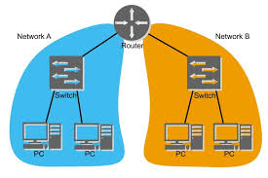
NETWORK components - SWITCHES
Switches
Connects devices within the same local area network (LAN) and intelligently forwards data to the correct device based on MAC addresses. Switches operate at the OSI model’s network layer (Layer 2).
There are many different types of switches available today, such as:
Unmanaged switches
Managed switches
Smart switch
Layer 2 switch
Layer 3 switch
PoE switch
Gigabit switch
Rack-mounted switch
Desktop switch
Modular switch

Slide 23
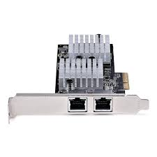
NETWORK components – NETWORK INTERFACE CARDS (NIC)
NIC
Any network-connected device includes a Network Interface Card (NIC). This card provides a dedicated connection between a computer and a network and manages the data transmission and reception. It is referred to as a card, originally designed as an expansion card inserted into a slot in the motherboard. Most NICs today are integrated directly into the motherboard. They come in various types, including:
  Wired (e.g., Ethernet)
  Wireless (e.g., Wi-Fi)
  Fiber optic

Slide 24
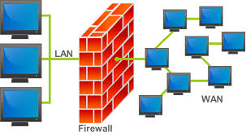
NETWORK components – FIREWALL
FIREWALL
A firewall is a network security device that establishes a barrier between trusted internal networks and untrusted external networks. A firewall connects multiple areas called zones, such as:
  Local Area Network
  Wide Area Network
  Demilitarized Zone

Slide 25
NETWORK components – FIREWALL
FIREWALL
Using assigned security policies, they filter traffic by examining data packets that flow between the different zones. The internet is, of course, the most untrusted network of all. Firewalls can also be placed within the internal network to isolate internal departments that host sensitive data, such as HR or Finance. Firewalls can be hardware-based, software-based, or a combination of both.

Slide 26
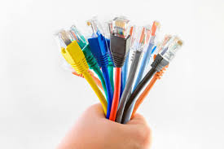
NETWORK components – Network Cables
NETWORK CABLES
A network cable is a physical medium to connect devices in a computer network. Common types include:
  Ethernet cables (e.g., Cat5e, Cat6)
  Coaxial cables
  Fiber optic cables.
  All network cables have an attenuation length, which means they can only carry digital signals for so long before a power source must energize them. This length varies depending on the cable type, quality, and transmitted signal frequency.

Slide 27
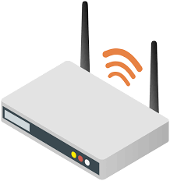
NETWORK components – Wireless Access Points (WAPs)
WAPS
A wireless access point (WAP) is a networking device with a built-in antenna, transmitter, and adapter. WAPs use the wireless infrastructure network mode to provide a connection point between WLANs and a wired Ethernet LAN. A WLAN essentially serves as an interconnection point between the WLAN and a fixed wire network.
A service set identifier (SSID) name is necessary to connect to a wireless network. The SID is used to identify all systems belonging to the same network, and client stations must be configured with the SSID to be authenticated to the WAP.

Slide 28
NETWORK components – Wireless Access Points (WAPs)
TYPES OF WAPS
There are many types of WAPs, such as:
Standalone Access Points:
Controller-Based Access Points
Cloud-Managed Access Points:
USB Access Points.

Slide 29
TYPES OF Network
Day 1

Slide 30
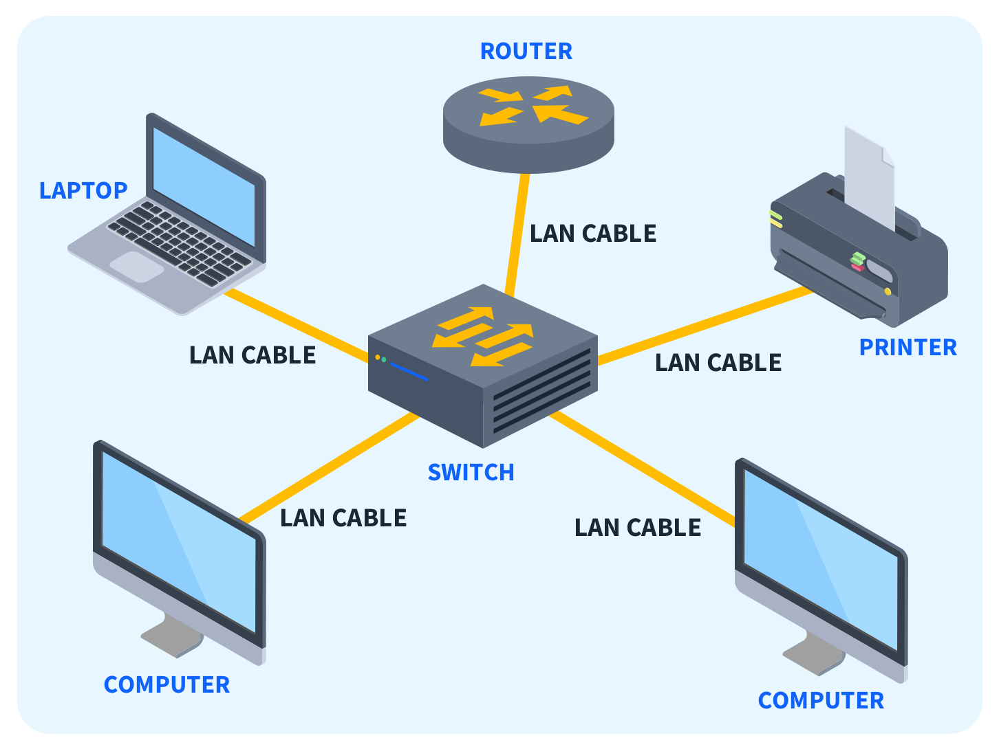
TYPES OF NETWORK– Local Area Network (LAN)
LAN
A Local Area Network (LAN) connects devices and computers within a limited geographic area, such as a home, office, or campus. Utilizing Ethernet cables or wireless technology, LANs facilitate fast data transfer and resource sharing. They are fundamental for file sharing, printing, and collaborative projects in office environments, fostering a cohesive digital environment

Slide 31
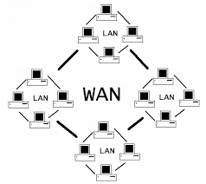
TYPES OF NETWORK– Wide Area Network (WAN)
WAN
A Wide Area Network (WAN) spans large geographical areas, connecting Local Area Networks (LANs) across cities, countries, or continents. To enable global communication, WANs use various technologies, including public and private networks. They are crucial for multinational corporations, providing a framework for efficient data transfer and communication between distant locations.

Slide 32
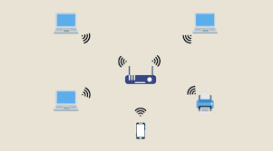
TYPES OF NETWORK– Wireless Local Area Network (WLAN)
WLAN
A Wireless Local Area Network (WLAN) employs wireless technology, allowing devices to connect without physical cables. This flexibility enhances mobility, making WLANs prevalent in homes, offices, and public spaces. Wi-Fi routers enable multiple devices to access the internet concurrently, emphasizing convenience and eliminating the need for extensive cabling.

Slide 33
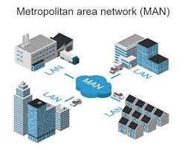
TYPES OF NETWORK– Metropolitan Area Network (MAN)
MAN
A Metropolitan Area Network (MAN) covers a city or a large campus, serving as an intermediary between Local Area Networks (LANs) and Wide Area Networks (WANs). MANs offer high-speed connectivity within a specific geographic region, supporting organisations with multiple offices or campuses nearby.

Slide 34
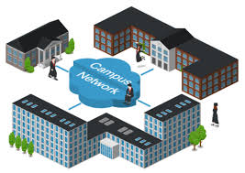
TYPES OF NETWORK– Campus Area Network (CAN)
CAN
A Campus Area Network (CAN) interconnects multiple Local Area Networks (LANs) within a specific campus or enterprise. CANs facilitate efficient data exchange among different departments, promoting seamless communication and resource sharing within the campus environment.

Slide 35
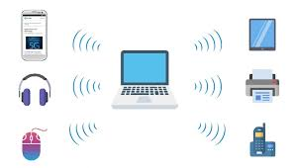
TYPES OF NETWORK– Personal Area Network (PAN)
PAN
A Personal Area Network links devices within an individual's workspace, typically covering a range of a few meters. PANs often use wireless technologies like Bluetooth or USB connections, enabling seamless communication between personal devices such as smartphones, laptops, and wearable gadgets.

Slide 36
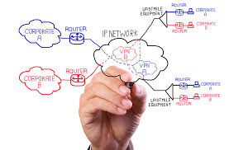
TYPES OF NETWORK– Virtual Private Network (VPN)
VPN
A VPN creates a secure, encrypted network over the internet, enabling secure remote access to a private network. VPNs are essential for remote work, allowing users to connect to their organization’s network securely from any location with internet access. However, it’s important to also consider the disadvantages of VPN when evaluating its use.

Slide 37
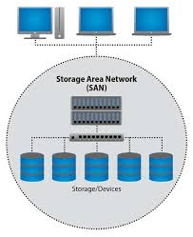
TYPES OF NETWORK– Storage Area Network (SAN)
SAN
A Storage Area Network (SAN) is dedicated to efficient data storage and retrieval. It separates storage resources from the main network, providing a centralized and scalable solution for managing and accessing large volumes of data. SANs are crucial for enterprises with extensive storage needs, enhancing data management and accessibility.

Slide 38
Network Models –OSI and TCP/IP
Day 1

Slide 39
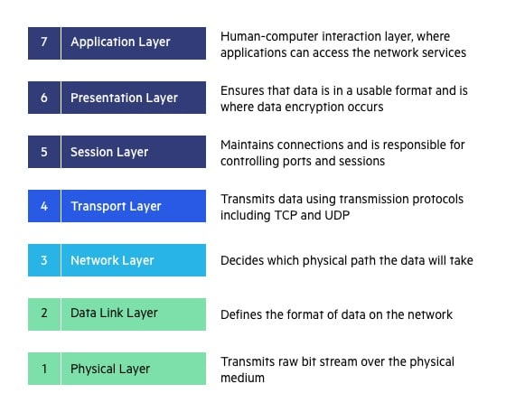
NETWORK LAYER models – OSI Model (Open Systems Interconnection)
OSI MODEL
The Open Systems Interconnection (OSI) model describes seven layers that computer systems use to communicate over a network. The OSI model is divided into seven distinct layers, each with specific responsibilities, ranging from physical hardware connections to high-level application interactions.

Slide 40
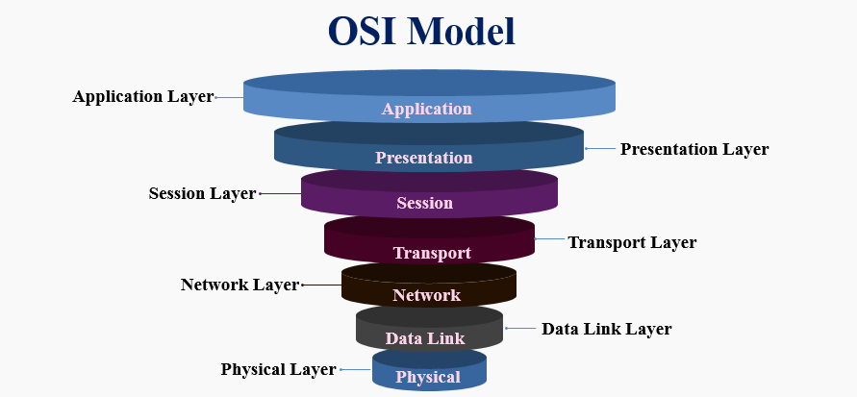
NETWORK LAYER models – OSI Model (Open Systems Interconnection)
OSI MODEL
Each layer of the OSI model interacts with the layer directly above and below it, encapsulating and transmitting data in a structured manner. This approach helps network professionals troubleshoot issues, as problems can be isolated to a specific layer. The OSI model serves as a universal language for networking, providing a common ground for different systems to communicate effectively.

Slide 41
NETWORK LAYER models – OSI Model (Open Systems Interconnection)
OSI MODEL
The OSI model was the first standard model for network communications, adopted by all major computer and telecommunication companies in the early 1980s. It was introduced in 1983 by representatives of the major computer and telecom companies, and was adopted by ISO as an international standard in 1984.
The modern Internet is not based on OSI, but on the simpler TCP/IP model. However, the OSI 7-layer model is still widely used, as it helps visualize and communicate how networks operate..

Slide 42
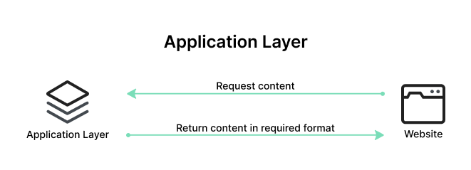
OSI Model - top down
APPLICATION LAYER
The Application Layer serves as the interface between the end-user applications and the underlying network services. This layer provides protocols and services that are directly utilized by end-user applications to communicate across the network. Key functionalities of the Application Layer include resource sharing, remote file access, and network management.
Examples of protocols operating at the Application Layer include Hypertext Transfer Protocol (HTTP) for web browsing, File Transfer Protocol (FTP) for file transfers, Simple Mail Transfer Protocol (SMTP) for email services, and Domain Name System (DNS) for resolving domain names to IP addresses. These protocols ensure that user applications can effectively communicate with each other and with servers over a network.

Slide 43
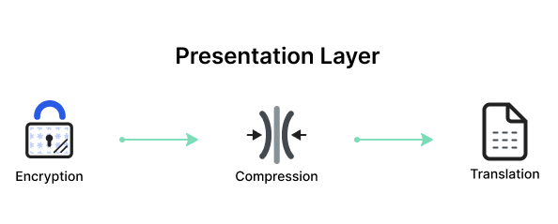
OSI Model - top down
PRESENTATION LAYER
The Presentation Layer, also known as the syntax layer, is responsible for translating data between the application layer and the network format. It ensures that data sent from the application layer of one system is readable by the application layer of another system. This layer handles data formatting, encryption, and compression, facilitating interoperability between different systems.
One of the key roles of the Presentation Layer is data translation and code conversion. It transforms data into a format that the application layer can understand. For example, it may convert data from ASCII to EBCDIC. It also includes encryption protocols to ensure data security during transmission and compression protocols to reduce the amount of data for efficient transmission.

Slide 44
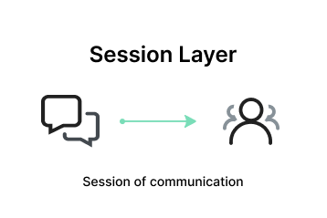
OSI Model - top down
SESSION LAYER
The Session Layer manages and controls the connections between computers. It establishes, maintains, and terminates connections, ensuring that data exchanges occur efficiently and in an organized manner. The layer is responsible for session checkpointing and recovery, which allows sessions to resume after interruptions.
Protocols operating at the Session Layer include Remote Procedure Call (RPC), which enables a program to execute a procedure on a remote host as if it were local, and the session establishment phase in protocols like NetBIOS and SQL. These services enable reliable communication, especially in complex network environments

Slide 45
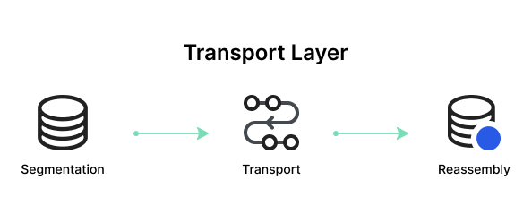
OSI Model - top down
TRANSPORT LAYER
The Transport Layer provides end-to-end communication services for applications. It ensures complete data transfer, error recovery, and flow control between hosts. This layer segments and reassembles data for efficient transmission and provides reliability with error detection and correction mechanisms.
Protocols at this layer include Transmission Control Protocol (TCP) and User Datagram Protocol (UDP). TCP is connection-oriented and ensures reliable data transfer with error checking and flow control, making it suitable for applications like web browsing and email. UDP is connectionless, offering faster, though less reliable, transmission, suitable for applications like video streaming and online gaming.

Slide 46
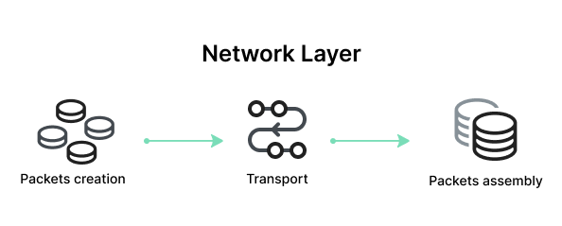
OSI Model - top down
NETWORK LAYER
The Network Layer is responsible for data routing, forwarding, and addressing. It determines the best physical path for data to reach its destination based on network conditions, the priority of service, and other factors. This layer manages logical addressing through IP addresses and handles packet forwarding.
Key protocols at this layer include the Internet Protocol (IP), which is important for routing and addressing, Internet Control Message Protocol (ICMP) for diagnostic and error-reporting purposes, and routing protocols like Routing Information Protocol (RIP) that manage the routing of data across networks.

Slide 47
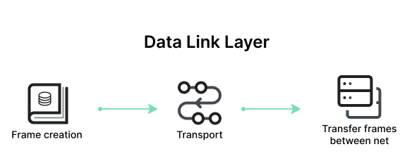
OSI Model - top down
DATA LINK LAYER
The Data Link Layer is responsible for node-to-node data transfer and error detection and correction. It ensures that data is transmitted to the correct device on a local network segment. This layer manages MAC (Media Access Control) addresses and is divided into two sublayers: Logical Link Control (LLC) and Media Access Control (MAC).
Protocols and technologies at this layer include Ethernet, which defines the rules for data transmission over local area networks (LANs), and Point-to-Point Protocol (PPP) for direct connections between two network nodes. It also includes mechanisms for detecting and possibly correcting errors that may occur in the Physical Layer.

Slide 48
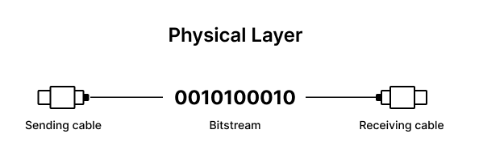
OSI Model - top down
PHYSICAL LAYER
The Physical Layer is responsible for the physical connection between devices. It defines the hardware elements involved in the network, including cables, switches, and other physical components. This layer also specifies the electrical, optical, and radio characteristics of the network.
Functions of the Physical Layer include the modulation, bit synchronization, and transmission of raw binary data over the physical medium. Technologies such as Fiber Optics and Wi-Fi operate at this layer, ensuring that the data physically moves from one device to another in the network.

Slide 49
How Does Communication Happen in the OSI Model? A Practical Example
Day 1

Slide 50
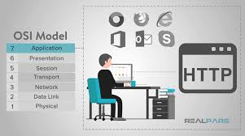
PRACTICAL EXAMPLE
Let’s consider how OSI layers play a role in an everyday activity like sending an email to a person overseas:
When a user in Nigeria sends an email to a colleague in South Africa, the process starts at the Application Layer (Layer 7). The user’s email client, such as Outlook, uses SMTP (Simple Mail Transfer Protocol) to handle the email message.
The email is then passed to the Presentation Layer (Layer 6), where it is formatted and encrypted to ensure proper transmission.
Next, the email moves to the Session Layer (Layer 5), where a session is established between the sender’s email server in Nigeria and the receiver’s email server in South Africa. This layer manages the session, keeping the connection open long enough to send the email.

Slide 51
PRACTICAL EXAMPLE
The email data then reaches the Transport Layer (Layer 4), where it is divided into smaller packets. TCP ensures these packets are sent reliably and in the correct order.
At the Network Layer (Layer 3), each packet is assigned source and destination IP addresses, allowing it to be routed through multiple networks, including routers and switches, to reach the recipient in South Africa.
The Data Link Layer (Layer 2) then uses MAC addresses to handle the packets’ journey across local networks and correcting any errors that occur.
Finally, the Physical Layer (Layer 1) converts the data into electrical signals, which are transmitted over fiber-optic cables under the Ocean.

Slide 52
PRACTICAL EXAMPLE
Upon reaching the recipient’s server in South Africa, the process is reversed:
The Physical Layer converts the signals back into data packets, which are reassembled at the Data Link Layer.
The Network Layer ensures the packets have arrived correctly, and the Transport Layer reorders them if necessary
The Session Layer maintains the session until the email is fully received.
The Presentation Layer decrypts and formats the email, and the Application Layer delivers the email to the client, where it appears in their inbox.

Slide 53
ADVANTAGES OF OSI MODEL
The OSI model helps users and operators of computer networks:
Determine the required hardware and software to build their network.
Understand and communicate the process followed by components communicating across a network.
Perform troubleshooting, by identifying which network layer is causing an issue and focusing efforts on that layer.
The OSI model helps network device manufacturers and networking software vendors:
Create devices and software that can communicate with products from any other vendor, allowing open interoperability
Define which parts of the network their products should work with.
Communicate to users at which network layers their product operates – for example, only at the application layer, or across the stack.

Slide 54
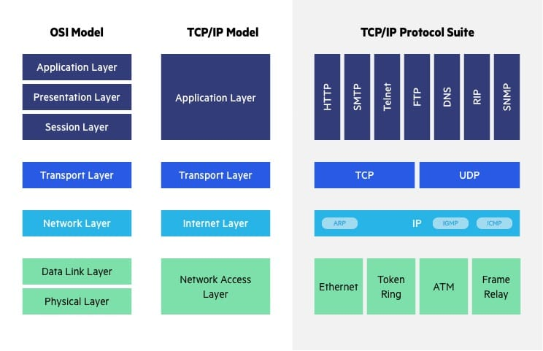
OSI vs. TCP/IP Model

Slide 55
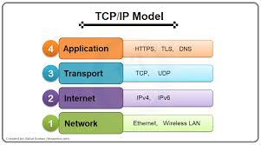
TCP/IP
The Transfer Control Protocol/Internet Protocol (TCP/IP) is older than the OSI model and was created by the US Department of Defense (DoD). A key difference between the models is that TCP/IP is simpler, collapsing several OSI layers into one:
OSI layers 5, 6, 7 are combined into one Application Layer in TCP/IP
OSI layers 1, 2 are combined into one Network Access Layer in TCP/IP – however TCP/IP does not take responsibility for sequencing and acknowledgement functions, leaving these to the underlying transport layer..

Slide 56
IMPORTANCE OF TCP/IP
TCP/IP is a functional model designed to solve specific communication problems, and which is based on specific, standard protocols. OSI is a generic, protocol-independent model intended to describe all forms of network communication.
In TCP/IP, most applications use all the layers, while in OSI simple applications do not use all seven layers. Only layers 1, 2 and 3 are mandatory to enable any data communication.

